Slide 1


Hello Friends….. Tic Tac Toe Game Present Here..
Presentation by
Yasmin Akter
Rubaya Sultana

Slide 2
CONTENT:
Background Study
Features
Platform

Slide 3
Background study:
Inroduction:
Many versions of tic tac toe like 3*3,4*4 and 9*9.Can be made on various platforms like javascript,python,Java,C.It's also
not a complex architecture
Two players game:
Huplayer and aipalayer
Winning Combinations in game:
In a tic tac toe game there are 8 possibilities to win the game.
The possibilities are getting the three combinations horizontally,three combinations vertically or two combinations diagonally as shown in the figure below.
Hence,the easiest way to find the determine winner of the game is to check for these eight combinations as the game goes on.

Slide 4
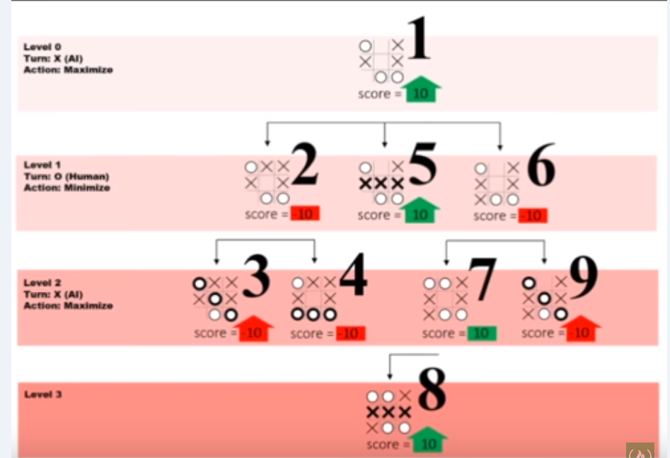
Mini-max algorithm following things:
Return a value if a terminal state is found (+10, 0, -10)
Go through available spots on the board
Call the minimax function on each available spot (recursion)
Evaluate returning values from function calls and return the
best value

Slide 5
Features:
Two players game.
Huplayer is first click for playing the game and then aiplayer give the click against huplayer.
The game is start and there is winning function,lose function and Tie function.
In this game css has been given differents color green,red,blue.
Platform:
It is a cross platform game.

Slide 6
Any Question ?

Slide 7
Thank You

